Slide 1
CS4042 – Information Processing Techniques(IPT)
Week – 04
Sep 13-17, 2021
Instructor: Syed Zain Ul Hassan

Slide 2
XML Technology
Derived from SGML (Standard Generalized Markup Language)
Text-based format
Describes document structures using markup tags
Useful for describing document formats for Web
It is also useful for describing both structured as well as semi-structured data.
Notes:
Text-based format means that one can read and edit an xml document using standard text editing tools

Slide 3
XML Technology
XML (Extensible Markup Language) can be explained using its name
Extensible: It lets you define your own tags
Markup: It contains tags
Language: It is a language similar to HTML

Slide 4
XML vs HTML
HTML describes how the web page is presented or its layout
HTML is a Data Presentation Language
XML uses tags to contain or describe data and relationship between data elements
XML is a Data Description Language

Slide 5
Why XML?
Platform-independent
Can be run over any operating System
Can be processed using any programming language
Extensible:
No fixed vocabulary
Flexible, change the structure by adding new tags
Supports Global implementation being fully Unicode
No emphasis on display and rendering the XML document

Slide 6
XML Skeleton
Syntax similar to HTML
Start tag <start>
end tag </start>
Case sensitive
White spaces are preserved
Elements must be properly nested
XML Infoset
Information items which are abstract representation of components of an xml document
Up to 11 information items including Document, element, attribute, processing instructions etc.

Slide 7
XML Syntax (Example)
<?xml version="1.0"?>
<note>
<to>Alpha</to>
<from>Beta</from>
<heading>Reminder</heading>
<Msgbody>Try to finish work today!</Msgbody>
</note>

Slide 8
XML Syntax (Example)
<?xml version="1.0"?>
The XML declaration should always be included. It defines the XML version of the document
<note>
Defines the first element (root) of the document. Each XML file can contain exactly one root element

Slide 9
XML Syntax (Example)
<to>Alpha</to>
<from>Beta</from>
<heading>Reminder</heading>
<Msgbody>Try to finish work today!</Msgbody>
The above lines define child elements (tags) in the XML file. These tags work quite similar to HTML tags
</note>
This line defines the end of the root element

Slide 10
XML Syntax (Attributes)
Attributes are used to provide information that is not a part of the content of the XML document
Example: <image src="computer.gif">

Slide 11
Skeleton
Schema Languages
Used to describe the structure and content of xml document
During document interchange describes the contract between the producer and consumer application
DTDs, XDR, XSD
XML APIs
Tree-model API – (full tree in memory)
XmlDocument Class in .NET, DOM, SAX
Cursor-based API – lens on one node at a time
XPathNavigator Class in .NET (only required fields in mem.)
XmlCursor class from BEA's XMLBeans toolkit
Streaming API
SAX, XMLPULL,
Object to XML Mapping API
include JAXB, the .NET Framework's XmlSerializer and Castor.
Notes:
XSD = XML Schema Definition
DTD = Document Type Definition
XDR = eXternal Data Representation

Slide 12
Skeleton
XML Query
In some cases data extraction from XML documents through available APIs is difficult or all of the data can not be extracted.
XPath, XQuery
XML Transformation
XSLT is the primary transformation tool
There are various vendor tools available for transforming XML to HTML, PDF, WORD, RTF etc.
Notes:
XSLT = eXtensible StyleSheet Language Transformations

Slide 13
Uses of XML
Traditional data processing
XML encodes the data for a program to process
Document-driven programming
XML documents are containers that build interfaces and applications from existing components
Archiving
Foundation for document-driven programming, where the customized version of a component is saved (archived) so it can be used later
Binding
DTD or schema that defines an XML data structure is used to automatically generate a significant portion of the application that will eventually process that data

Slide 14
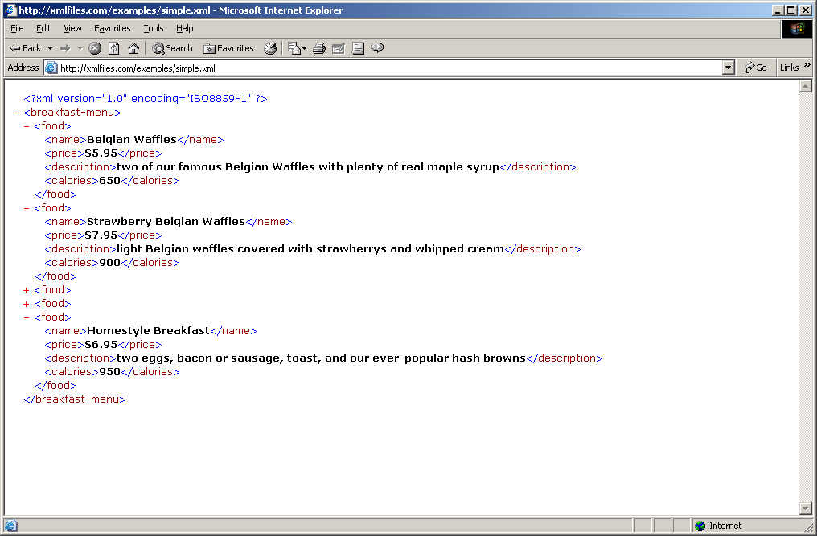
Schema Anatomy of XML document

Slide 15
XSD
<?xml version="1.0"?> <xs:schema xmlns:xs="http://www.w3.org/2001/XMLSchema"> <xs:element name="note"> <xs:complexType> <xs:sequence> <xs:element name="to" type="xs:string"/> <xs:element name="from" type="xs:string"/> <xs:element name="heading" type="xs:string"/> <xs:element name="body" type="xs:string"/> </xs:sequence> </xs:complexType> </xs:element> </xs:schema>

